Slide 1

SUDOKU SOLVER
Google Android Data Structures Project
Team:
Rakshith h v
Pruthviraj M Urankar
SAI PRAVEEN

Slide 2
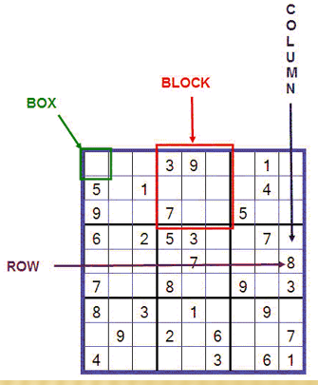
Problem Statement:
Our job is to design an algorithm which places a number into every empty box so that each row across, each column down, and each small 9-box square will contain each number from 1 through 9.

Slide 3
Introduction to problem:
A standard Sudoku contains 81 cells, in a 9×9 grid, and has 9 boxes, each box being the intersection of the first, middle, or last 3 rows, and the first, middle, or last 3 columns.
Each cell may contain a number from one to nine, and each number can only occur once in each row, column, and box.
A Sudoku starts with some cells containing numbers (clues), and the goal is to solve the remaining cells. Proper Sudokus have one solution.

Slide 4
Methodology- Back Tracking:
Sudoku puzzle can be solved using a simple backtracking algorithm.
What is Backtracking Programming?
Recursion is the key in backtracking programming. As the name suggests we backtrack to find the solution. We start with one possible move out of many available moves and try to solve the problem if we are able to solve the problem with the selected move then we will print the solution else we will backtrack and select some other move and try to solve it. If none if the moves work out we will claim that there is no solution for the problem .

Slide 5
Backtracking is implemented using the data structure Stacks.
Like all other Backtracking problems, we can solve Sudoku by one by one assigning numbers to empty cells. Before assigning a number, we check whether it is safe to assign. We basically check that the same number is not present in current row, current column and current 3X3 subgrid(block). After checking for safety, we assign the number, and recursively check whether this assignment leads to a solution or not. If the assignment doesn’t lead to a solution, then we try next number for current empty cell. And if none of number (1 to 9) lead to solution, we return false.

Slide 6
Algorithm
Step 1: Find an unassigned cell.
If there is none, return true.
Step 2: Assign digits from 1 to 9:
a) If there is no conflict for digit at row, column assign digit to the cell and recursively try fill in rest of grid.
b) If recursion successful, return true.
c) Else, remove digit and try another.
Step 3: If all digits have been tried and nothing worked, return false

Slide 7
THANK YOU

